Slide 1
Healthy Habits for Healthy Humans: Reducing exposure to toxins in everyday life

Slide 2
Everything is Made of Chemicals
Some are helpful (e.g. medicine, water)
Some are harmful (toxins)
Found outdoors, indoors, in food, cosmetics, and more
You can take steps to protect yourself from toxins in your home
Notes:
Everything is made up of chemicals. Many of these are helpful to us, like medicines, food, or even water. But many we interact with are toxic. Toxic means that it may cause death or illnesses such as cancer or hormone disruption. They can be found outdoors and indoors, in food, cosmetics, dust. They’re everywhere. But we can take steps to protect ourselves from toxic substances in our home, and many of these steps will also save you money!

Slide 3
Who Is At Risk?
We all are!
Even more so if you are:
A child or youth
Pregnant
First Nations or Inuit
People in high areas of toxic exposure
A senior
Already ill
Notes:
Everyone is at risk! Everyone is exposed to toxic substances and at risk of experiencing the dangerous effects of these toxic chemicals. Some groups have additional risk and are listed here, children, pregnant mothers, seniors or those already ill including chronic illness, or if you experiencing some social inequities like many of our First Nations, Inuit and people in remote communities as well as groups who live or work in areas of high levels of toxic exposure.

Slide 4
Routes of Exposure
Breathing
Eating and drinking
Absorption through skin
Exposure via the placenta
Notes:
The chemicals that we are going to talk about today are not ones that you can see, smell, or taste, but they can get in our body as we go about our daily lives. We can be exposed to them by breathing, eating and drinking, absorption through the skin, and for a baby, exposure can occur through the placenta.

Slide 5
May Contain Toxic Chemicals
Notes:
Here are some examples of how we are exposed to toxic chemicals. All of these things can have toxic chemicals in them.

Slide 6
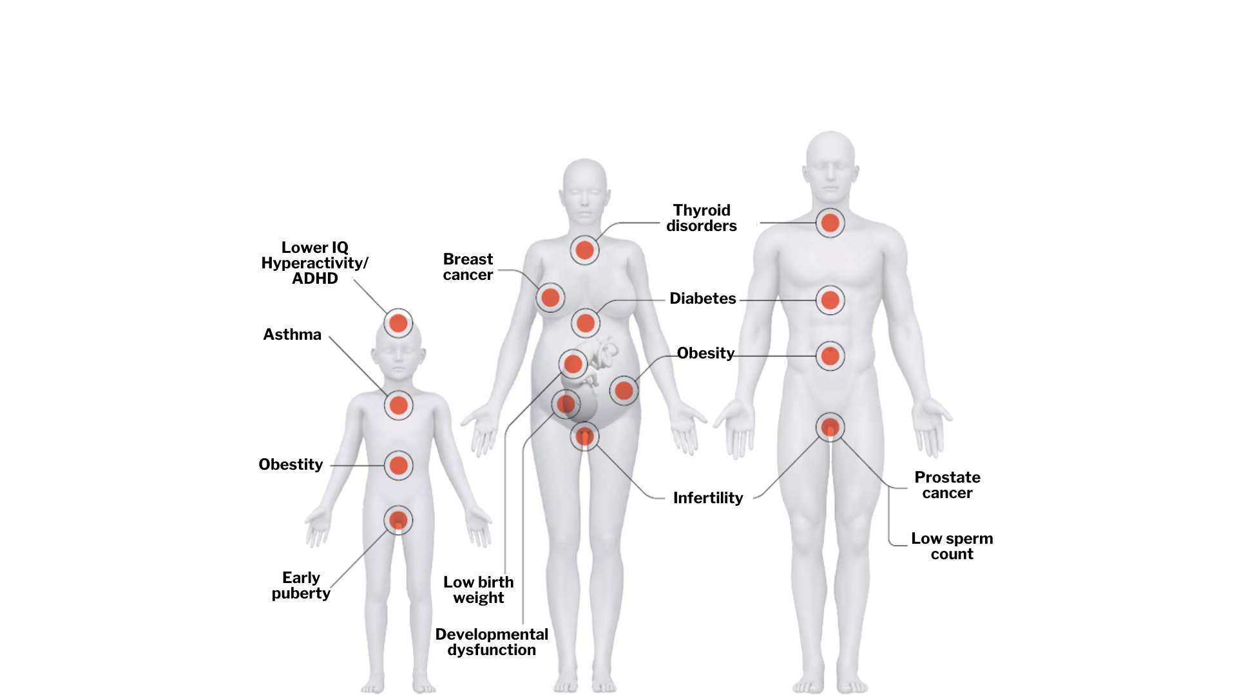
Effects of Exposure
Notes:
This graphic shows a number of systems of the body that can be affected by the exposure to toxic chemicals. In children there is an added risk of lower IQ, hyperactivity or ADHD, and Asthma, and early puberty. Infertility in women and men. Developmental dysfunction and low birth weight in babies when pregnant women are exposed. Diabetes, thyroid disorders and sex organ cancers in adults are all possible effects. Some of these are caused by endocrine-disrupting chemicals when they interfere with the natural hormone processes in our bodies, others such as low IQ are caused by exposure to heavy metals.

Slide 7
Effects of Exposure
The chemical characteristics
Level and duration of exposure
Age and gender of person exposed
Genetics
Pre-existing health conditions
Exposures to other chemicals, stress poor nutrition
Notes:
The health risks of exposure depend on a complicated combination of many factors.
The chemical characteristics
Level and duration of exposure
Age and gender of person exposed
Genetics
Pre-existing health conditions
Exposures to other chemicals, stress poor nutrition

Slide 8
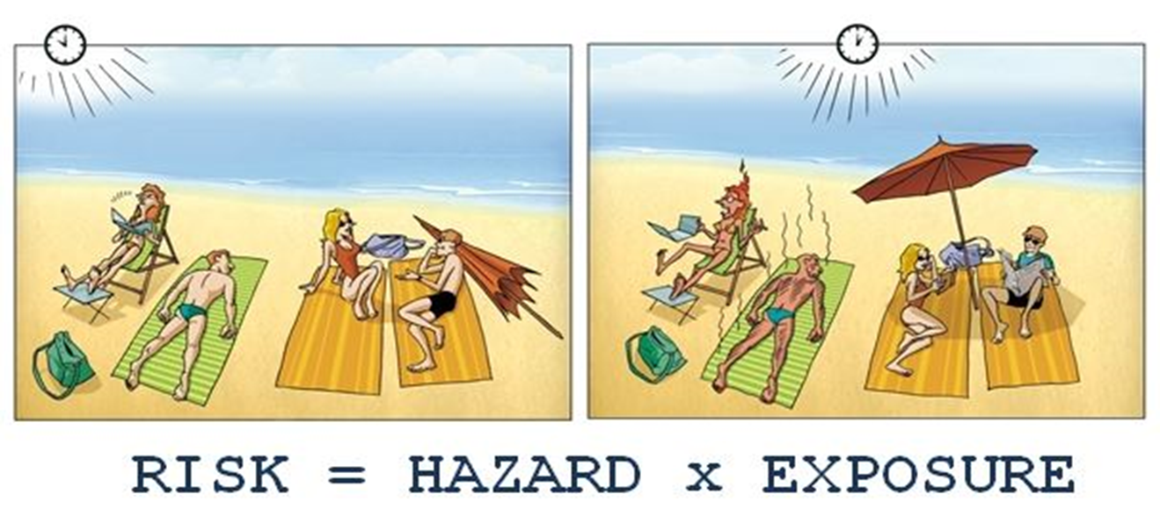
Source : Toxicology Education Foundation : http://toxedfoundation.org/hazard-vs-risk/
Notes:
This graphic shows an example of how we can reduce risk by changing either the type of the risk or the duration of exposure to the risk..

Slide 9
Common Sources Of Toxins In Our Homes
Air
Dust & MOULD
Plastics
Foods
Personal Care Products
Notes:
We are going to talk about avoiding risk of exposure to toxic chemicals in our homes. Everyone will have some contact with these hazards. We’re going to look at toxic chemicals in the air, the dust and mould in our homes. In plastics, foods and personal care products.

Slide 10
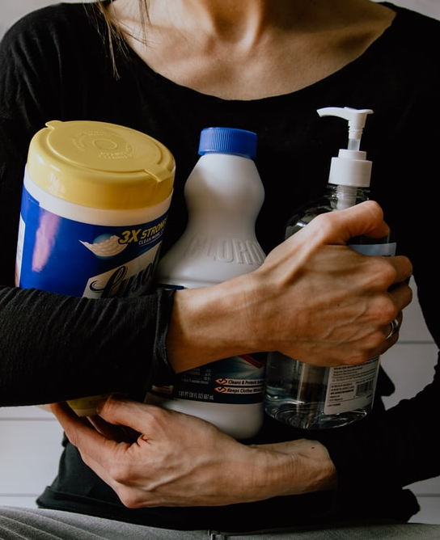
Indoor Air Risks
Main sources of poor air quality
Cigarette/vape/cannabis smoke
Fire places and furnaces
Fragrances
Scented cosmetics, cleaners
Chemical cleaners and pesticides
Radon gas and carbon monoxide
Mould
Notes:
The Main sources of poor air quality indoors include
Cigarette/vape/cannabis smoke
Wood stoves, wood and oil furnaces inside your house
Fragrances
Which includes things like scented cosmetics and personal care products, cleaners, air fresheners, and candles
Chemical cleaners used in the house
Pesticides from the lawn and garden and used in the house (Raid, etc.)
Radon gas and carbon monoxide
And mould

Slide 11
Minimize Exposure to Smoke
Do not allow any smoking or vaping inside your home
Consider quitting, this can also save you money
Health experts recommend that you not burn wood
If you must burn wood
Use an efficient, certified model
Have it cleaned & inspected annually
Use only clean, dry wood and burn it HOT
Notes:
It’s pretty straightforward to minimize your exposure to smoke. If someone in your residence smokes, always make sure that smoking takes place outside the residence and away from doors and windows so that the people indoors are not exposed. Of course, quitting is the best course of action for you and your household. For some, the money-saving factor of quitting can be highly motivational. If you want to quit smoking and are struggling, ask your doctor for help.
Health experts recommend that you not burn wood either inside your home as a source of heat, for cooking, or outside for bonfires. If you must use wood as fuel, it’s important to use an efficient, certified model of woodstove. Have your woodstove cleaned and inspected for safety and efficiency. If you see any smoke coming from the chimney, you are wasting money. Smoke is a product of incomplete combustion. By learning how to “burn it hot” you can learn different ways to maximize the amount of heat out of your fuel and get the biggest bank for your buck.
Source: Code of Practice for Residential Wood Burning Appliances- https://www.ccme.ca/files/Resources/air/wood_burning/pn_1479_wood_burning_code_eng.pdf

Slide 12
Reduce Radon
Naturally-occurring radioactive gas
Enters buildings through foundations
Leading cause of lung cancer in non-smokers
Test your home and encourage other to as well
Notes:
You may not have heard of Radon gas. It’s a naturally occurring radioactive gas. It enters buildings through small cracks in the foundation and around pipes that come through the floors or walls. Every building will have radon in it, so you need to know how much radon there is.
Radon gas is the leading cause of lung cancer in non-smokers.
Radon gas is sneaky because it has no smell, taste or colour. It doesn’t cause headaches or any other short term symptoms no many how much radon is present. It may take years of exposure to cause cancer. So the only way to know how much radon your home has is to test for it.
It is really easy to test for radon. Contact home building supply stores, radon specialists and technicians, and your local Lung Association, where they sell affordable test kits that you can send to a lab to find out your results.
The guideline for radon is 200Bq/m^3 (becquerels per cubic metre). If your level is close or over 200 Bq/m^3, you should have a radon technician install a depressurization system in your foundation.
Source: Health Canada- https://www.canada.ca/en/health-canada/services/health-risks-safety/radiation/radon.html

Slide 13
Keep A Scent-Free Home
Choose unscented:
Personal products
Laundry products
Cleaning products
Garbage bags
Avoid air fresheners, incense, and scented candles
Notes:
Scented products contribute to indoor air pollution. Scents in products can be made up of hundreds of chemicals that can be harmful to us. And so we recommend that you avoid scented products all together. There are usually many unscented options available in stores. But make sure to check the ingredients list for “fragrance” or “parfum” even if the label says “unscented”.
Common scented items we use include cosmetics, skin care products, shampoo, feminine hygiene products, and even trash and pet clean-up bags!
Laundry products including detergents, fabric softener, and dryer sheets,
And home cleaning products like dish soap, Windex, and all-purpose cleaner all can contain fragrances.
Avoid air fresheners, incense, and scented candles. This also includes car air fresheners and those electric machines that heat scented wax. If you are using a scented product to cover up an unpleasant smell, it’s more important to find out what that smell is and correct it. Cleaning the source of the smell and opening a window can effectively disperse an unpleasant smell.
Source: David Suzuki on Fragrances- https://davidsuzuki.org/queen-of-green/dirty-dozen-parfum-fragrance/
Home made unscented cleaners- https://davidsuzuki.org/wp-content/uploads/2017/10/queen-of-green-green-cleaning-recipes.pdf
https://www.lesstoxicguide.ca/index.asp?fetch=household
https://www.ewg.org/guides/cleaners/content/cleaners_and_health/

Slide 14
Household Cleaning
What is dust? Dead skin Hairs Soil Fungal spores Chemical Residues Deterioration of stuff
Notes:
We’re talking about having bad odours in the house, so let’s talk about household cleaning. We’ll start with dust!
So first, What is dust? It’s actually a little bit of everything. It has bits of dead skin, hairs, soil that was brought into the house on shoes, it could have fungal spores or pollen from outdoors. There can be chemical residues and particles from the deterioration of the items in your home. What toxic chemicals are in your household items?
Source: Health Canada on dust- https://www.canada.ca/en/health-canada/services/chemicals-product-safety/dust-mites.html

Slide 15
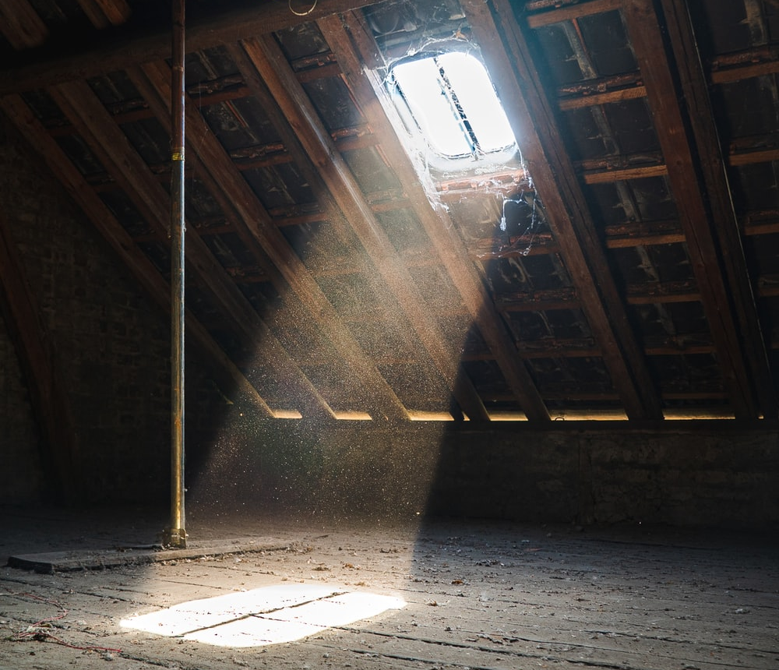
Household Cleaning
 | Dust also contains: Flame retardants Phthalates Pesticides Lead Mercury Arsenic
Notes:
Couches, carpets, and TVs could be coated with flame retardants, it may have some phthalates, there may be pesticides that come into your house on shoes. Maybe you are bringing in lead, mercury, or arsenic from the soil on your shoes as well. All these can end up as part of the dust in your home.

Slide 16
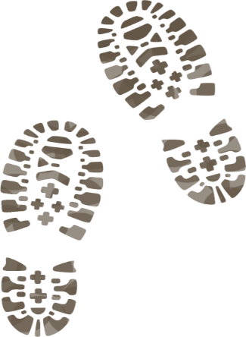
Minimizing Dust
Remove footwear at the door
Dust regularly with a damp cloth
No expensive sprays or wipes needed!
Vacuum and wet mop weekly
(more often if you have a crawling child)
Notes:
A super easy way to minimize the toxic chemicals in your dust at home is to remove your footwear at the door. Keep your outdoor shoes at the door. If you’re the type of person who likes to wear shoes indoors, just keep a separate pair of shoes that you wear at home.
Dusting regularly of course will minimize the dust buildup. And all you need is a damp cloth, you don’t need any fancy sprays.
-When vacuuming it is best to have a HEPA filter or a central vacuum. HEPA stands for High Efficiency Particulate Air. And also wet mop with water, again you don’t need added products to pick up the dust in your home. If you have small, crawling kids it’s best to do this more often. Kids spend more of their time on the floor where dust accumulates. And they are very likely to put things they find in their mouths.

Slide 17
Minimizing Dust
Reduce clutter to make dusting easier
Store loose items in a closed bin or cabinet
Dust under furniture and electronics often
Notes:
One of the best ways to reduce dust is to remove clutter from your home. This will make dusting easier.
Nick-knacks or rarely used items can be stored in a closed bin or cabinet so that they aren’t collecting dust.
Dusting under furniture and electronics is important. Furniture and electronics usually contain flame retardants which are hazardous to our health, so we want to pick that up before it moves around the house.
If you’re doing some deep cleaning, make sure to move your bigger furniture pieces to vacuum and wet mop behind and under them. Move the bookshelf, dresser, couch, etc to pick up the dust that’s been hiding for a longer period of time.
-remove older carpets from your home if possible. You don’t need to replace them with an expensive floor, you can paint the plywood underneath with low emission paint!

Slide 18
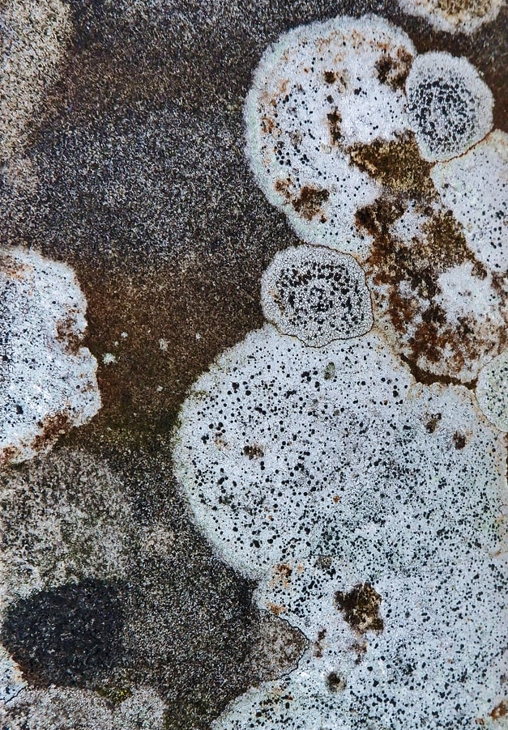
Mould In Your Home
Don’t ignore it
Excessive and toxic moulds can affect your family’s health
Irritation, coughing, symptoms of asthma, allergic reactions, eczema
Notes:
Mould is always present inside your home, but excessive mould is a bit more obvious than most of the toxic substances we’ve been talking about.
If you see or smell mould in your home, don’t ignore it. Take action immediately. And in just a couple of slides, we’ll discuss some actions you can take.
Mould can be hazardous to our health
For example, excessive and certain toxic types of mould in the home can cause: Eye, nose and throat irritation, coughing and phlegm build-up, wheezing and shortness of breath, eczema, and symptoms of asthma and allergic reactions
Source: Health Canada on Mould- https://www.canada.ca/en/health-canada/services/publications/healthy-living/residential-indoor-air-quality-guideline-moulds.html

Slide 19
Mould In Your Home
Common places to find mould:
Basements
Bathrooms
Window sills
Carpets and fabrics
Laundry areas
Notes:
You’re likely to find mould in basements, bathrooms – especially under sinks or around toilets and tubs, around window sills- look for condensation around the window, carpets and fabrics, and laundry areas. Mould could be present anywhere there is excess moisture that hasn’t been ventilated properly.

Slide 20
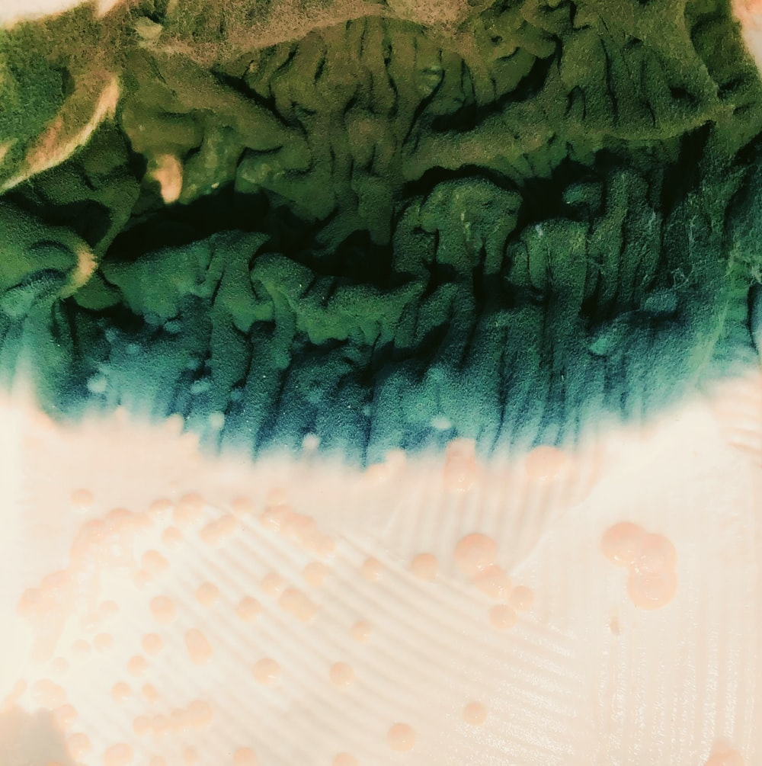
How To Recognize Mould
Musty smells
Commonly black, white
Can be red, blue, or green
Notes:
Mould is usually easy to recognize.
There’s typically a musty smell that accompanies it, it’s usually black or white and fuzzy.
But it can be many other colours like red, blue, or green.

Slide 21
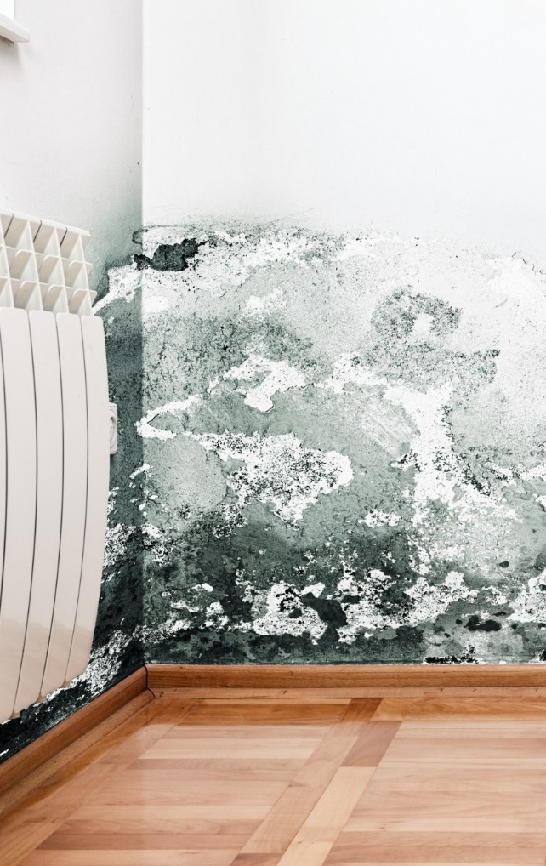
What To Do: Mould
Small areas of mould can be cleaned with dish detergent
Larger areas may require a professional
Correct the cause of the moisture problem or mould will return
Use a dehumidifier, seal cracks in the basement wall, insulate
Notes:
If you have just a little bit of mould, dish detergent is an effective way to clean it up.
A small area means an area of up to 1 meter by 1 meter.
An area larger than that will likely require a professional to clean up.
Either way, in addition to cleaning the mould, you need to correct the moisture problem that caused it in the first place. Otherwise the mould will return.
A few simple ways to prevent mould from growing is to use a dehumidifier, use a bathroom fan when showering, turn on the stove vents in your home when cooking (especially boiling water), crack a window when you are mopping or other wet cleaning.
If you can, make sure that your stove is vented to the outdoors.
Make sure that your dryer is properly vented outside.

Slide 22
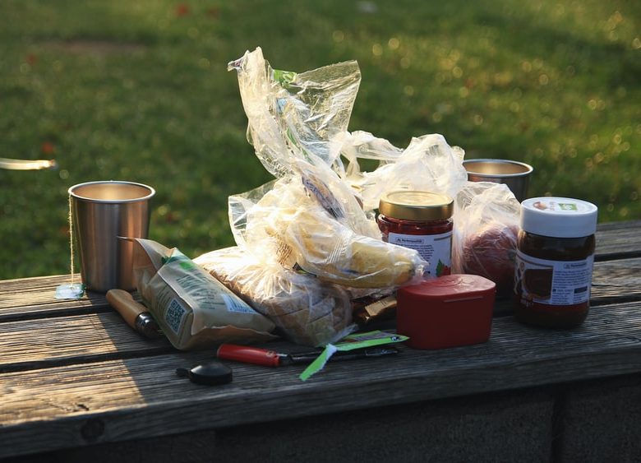
Why Are Plastics So Bad? (OTHER THAN ENVIRONMENTAL IMPACTS)
Contain harmful chemicals
Plasticizers: phthalates, bisphenols and styrene
Leach toxins when heated
Only some will get recycled
Notes:
There’s a lot of talk about plastics these days, especially on the environmental effects. From the pollution of single use plastics and harm of the extraction of petroleum oil which makes plastics.
And on top of that, plastics are harmful to our bodies. They contain harmful chemicals called plasticizers including phthalates, bisphenols and styrene.
These chemicals leach even more when they are heated.
And although many plastic products have a recycling symbol on the bottom, not many plastics are actually recycled to be used again. For example, colourful or black plastics and funnily shaped plastics rarely get recycled. Check your city’s recycling policy to see what numbers are processed in your municipality.
Source: Information on plastics- https://ecologycenter.org/plastics/

Slide 23
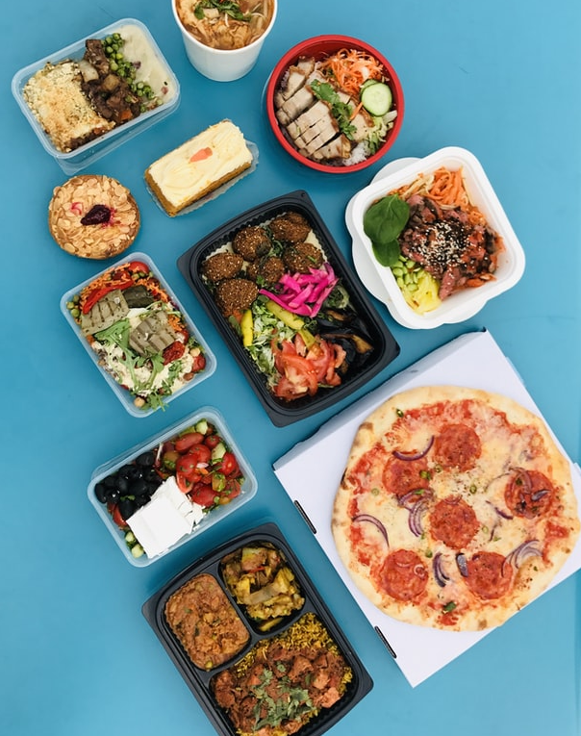
Heat, Plastic, & Food
Store leftovers in glass or ceramic
If you use plastics, allow hot foods to cool first
Use your plastic containers for cold and non-fatty and non-oily food storage
Notes:
Heat, plastic and food do not mix. The heat allows chemicals to move into the food that is being stored inside.
Store hot leftovers like soup or a casserole in glass or ceramic
If you must use plastics to store foods, allow hot foods to cool prior to filling the container. But do not re-heat in this container! Move the food to a ceramic or glass dish to heat.
It’s considered safe to use your plastic containers for cold, non fatty or oily food storage or pantry items. So you don’t need to get rid of all your plastic containers! But use only with cold items! Fat and oil can also absorb chemicals from the plastic.

Slide 24
Plastics and Toys
For food storage and toys: Use only 1, 2, 4, and 5 Avoid 3, 6, and 7
Choosing toys that are labeled “PVC free”, “phthalate free”, “BPA free”, or “vinyl free”
Check to ensure toys have not been recalled
Notes:
Something not everyone knows about plastics is that not all are safe for food and toys. The recycling number on the bottom tells us that information. Numbers 1, 2, 4, and 5 are considered safe for food and toys. But don’t add heat to the mix!
We want to avoid number 3, 6, and 7 entirely when it comes to food storage and children’s toys.
When it comes to toys you can also check for labels that say “PVC free”, “phthalate free” or “BPA free”. “vinyl free”
And if you have children in your life, make sure to be checking the Health Canada recall list. They list any toys or children's products that have been recalled. You can even sign up to get alerts for different recalls.
Source: Health Canada recalls- https://www.healthycanadians.gc.ca/recall-alert-rappel-avis/index-eng.php

Slide 25
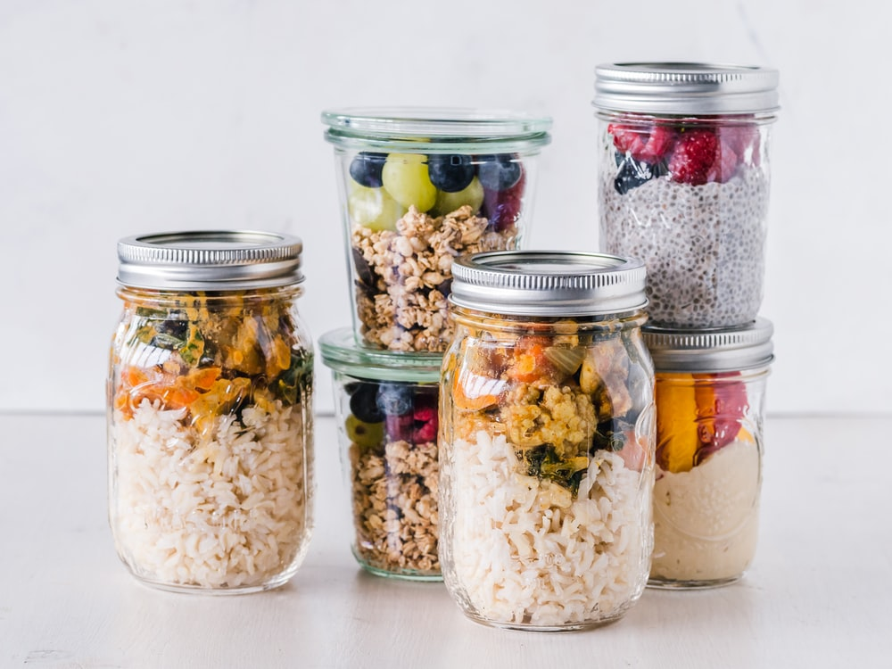
Alternatives To Plastics
Food storage:
Stainless steel
Glass
Ceramic
Bees wax wraps
Notes:
Plastic is hard to avoid. But there’s a couple of key areas where you can reduce the plastic in your life that can also have a positive effect on your health.
For food storage, the alternatives are stainless steal, glass, and ceramic cookware. Beeswax wraps are a great replacement for plastic cling wrap.
-When buying replacements for plastic storage first consider checking out you local second hand stores (you do not need to spend a fortune)
Source: David Suzuki going Zero-Waste- https://davidsuzuki.org/queen-of-green/how-to-go-zero-waste/

Slide 26
Alternatives To Plastics
Shopping:
Reusable bags
Baskets
Mesh produce bags
Buy naked produce if available
Notes:
When shopping, reusable bags, made of cloth or whatever bags you might have at your home.
You might also see people using baskets instead of a bag, especially if you’re at a farmers market.
You can use mesh produce bags in place of the plastic produce bags available. This means choosing the “naked” fruit or veggies that do not come pre-packaged. Often there are peppers on the shelf in a plastic bag already or peppers sitting “naked” on the shelf.
If you forget your mesh produce bags or don’t have any, consider putting the produce into your bag as is. Especially if you are just picking up one or two of that item, any bag is not necessary. You should be washing your produce when it gets home, anyway.
Source: Environmental Defence, ending plastic pollution- https://environmentaldefence.ca/campaign/ending-plastic-pollution/

Slide 27
Alternatives To Plastics
Going out:
BYO container
BYO utensils
Refuse the straw or BYO
BYO mug/bottle
Notes:
Some of the advice here is not practical at the moment because of policies surrounding Covid-19. We’re going to discuss anyway so that at certain locations or in the future you will be informed of some options.
When getting take out or bringing home leftovers, bring your own container with you! You can also bring your own utensils for fast food, food trucks, or takeout. When it comes to straws, you can ask them not to bring you one. If you like straws, you can bring your own. There are metal, glass, and silicone.
Coffee shops are very open to using a travel mug or thermos that you bring with you, and some will even give you a discount. If you’re a daily coffee drinker and have a habit of buying coffee once you’re out of the house, consider getting up a few minutes earlier and making your coffee at home. This is significantly cheaper and will cut out a bit of waste with every cup of coffee. And remember to bring a bottle already filled with water with you everywhere you go so that you don’t need to buy one. Utensils, straws, reusable containers and water bottles often can fit into a backpack or beach bag, or you can keep them in your car so you have them on hand when you need them.

Slide 28
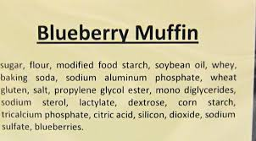
What’s Going Into Your Body?
Not all items on the grocery store shelf are good for you
Choose items with simple, whole ingredients
Notes:
Do you know what’s going into your body? From pesticides and mercury to added flavour and colour it is harder and harder to know what you are putting into your body.
Sadly, just because a food item is on the shelf at the grocery store, it doesn’t mean that it’s good for you to eat.
Choose foods that have simple whole ingredients. Look at the example on the side: There are two ingredient lists for blueberry muffins. One list on the left has ingredients that are familiar words, and whole and recognizable ingredients. The other list of ingredients is very different, with many items not found in a kitchen, like propylene glycol ester and silicon.

Slide 29
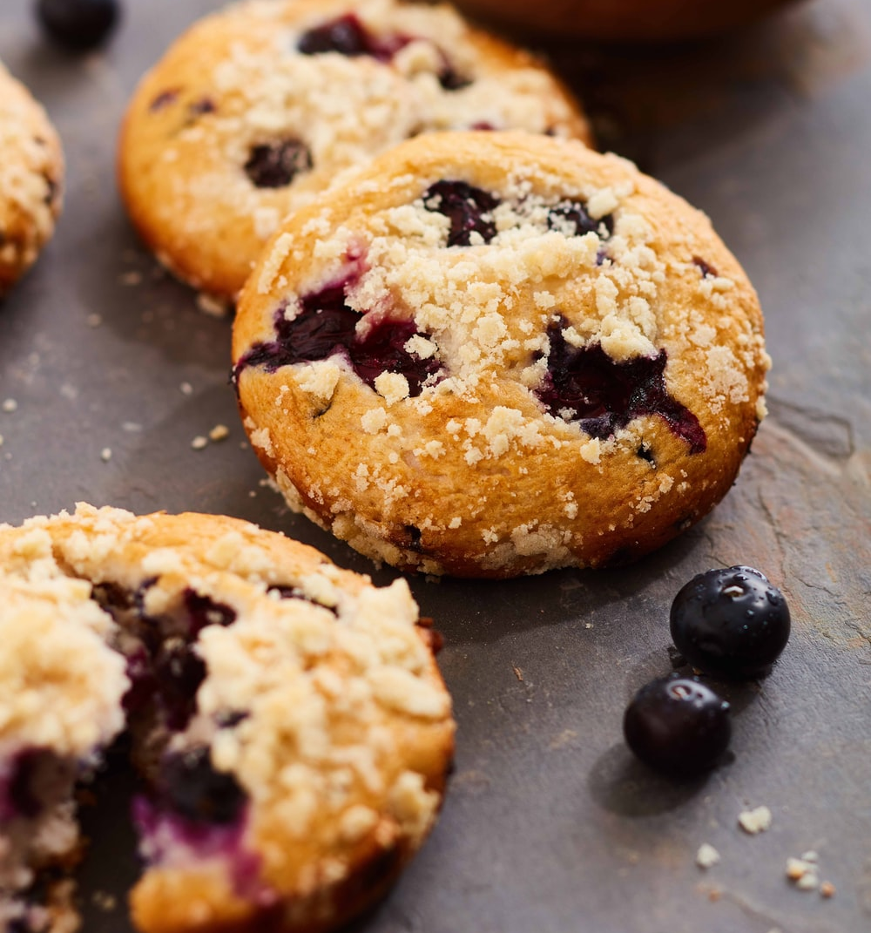
What’s Going Into Your Body?
Avoid foods that:
Have modified ingredients
Have artificial additives & flavours
Are high in sodium
Are not sustainably sourced
Notes:
Avoid foods that have modified ingredients, artificial additives and flavours including hydrogenated or trans fat and sugars like high-fructose corn syrup, maltose and dextrose. Also avoid foods that are high in sodium (salt), that have it listed high up in their ingredients list. And ideally look for food that has been sustainably sourced, especially fish. Do research on where the product was sourced and processed, and look for certifications like FairTrade and EcoCert.
Sources:
Health Canada on Chemical contaminants in food- https://www.canada.ca/en/health-canada/services/food-nutrition/food-safety/chemical-contaminants.html
Center for Science in the Public Interest on “Chemical Cuisine” - https://cspinet.org/eating-healthy/chemical-cuisine
Safe Food Matters on Glyphosate - https://safefoodmatters.org/2019/11/10/glyphosate-main-crops-of-concern-and-why/?fbclid=IwAR3v70XPjbLeXz5I4n0nlZ6i6O7y0nvxab0LMM2gNOJ1N7XWm_JU33aLZ2g

Slide 30
Steps To A Healthier Plate
Cook at home more often
Buy local and sustainable
Buy fresh, in season, or frozen fruits and veggies
Rinse fresh produce
Choose low mercury fish
Notes:
There are many ways that people can take steps to have a healthier plate! Some of these can help you save money, as well. You may be able to implement all of these, but more likely you can do one or two.
Cook at home more often. Avoid eating out or eating pre-prepared foods.
Buy local, in season, and sustainable (organic) food when you can
Buy fresh, in season, or frozen fruits and veggies in the winter- we recommend you avoid buying canned foods as the liner may contain bisphenol S or F, these are BP plastics (may be BPA-free but not BP free)
Rinse fresh produce when you bring it home
Choose low mercury fish. Mercury is common in our water systems. It’s persistent and it enters fish tissues which means that there is more mercury in the fish that are higher in the food chain. So choosing low mercury fish is choosing fish that are low on the food chain like mackerel, rainbow trout, wild or canned salmon, and tilapia. Mercury is especially dangerous to young kids and pregnant women, and even women who want to be pregnant someday. Because mercury will stay in our bodies, and will travel through a placenta into a fetus.
Source: Health Canada on Tips for healthy eating- https://food-guide.canada.ca/en/tips-for-healthy-eating/

Slide 31
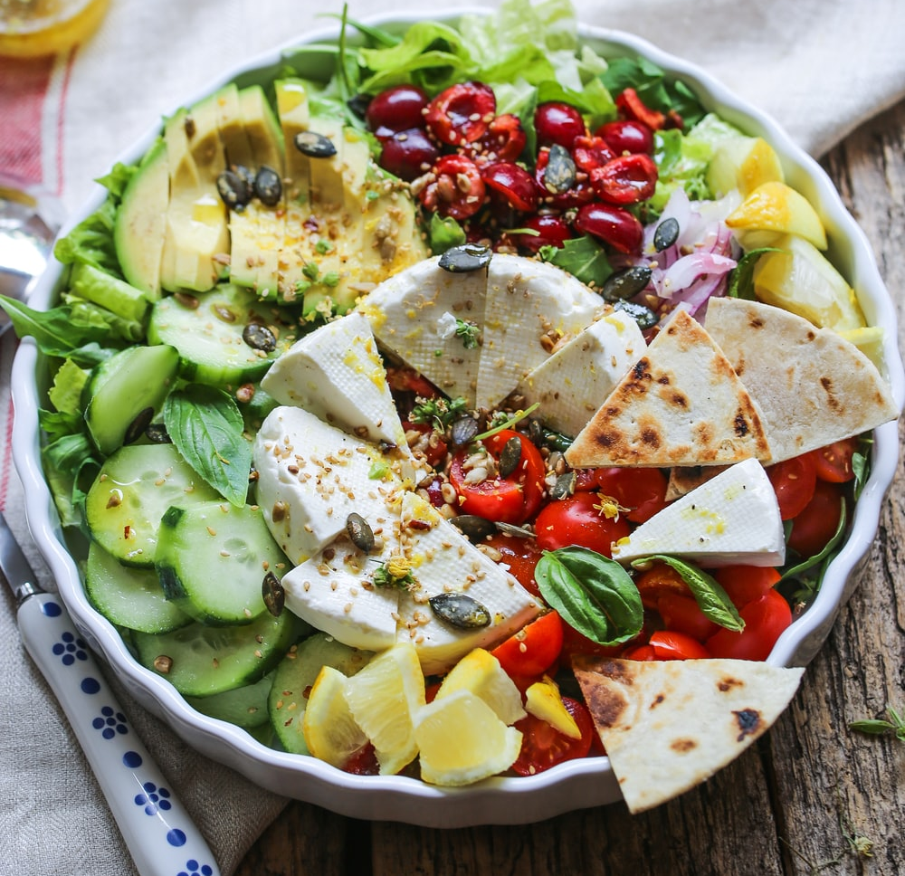
Steps To A Healthier Plate
Avoid using non-stick cookware
Ensure your water is safe for cooking
Use a thermometer when cooking meats
Store leftovers in the fridge ASAP when no longer steaming hot.
Notes:
Avoid non-stick cookware, which we’ll talk about a bit more in the next slide. But the coating on non-stick cookware contains polyfluorinated alkyl substances (PFAS,PFOS). These are endocrine disrupting chemicals.
Make sure that your water is safe to drink and cook with. If you have well water, it should be tested regularly, every 6 months to a year for bacteria, arsenic, lead, and more toxic substances. Municipal water is tested by the city to ensure safety.
Using a thermometer when cooking meats makes it super easy. These cost only 10 or 15 dollars and they allow you be have confidence that the meat has been cooked thoroughly to health standards.
To avoid bacteria, store any leftovers in the fridge as soon as possible when no longer hot. It is not a good idea to put very hot food into the fridge.

Slide 32
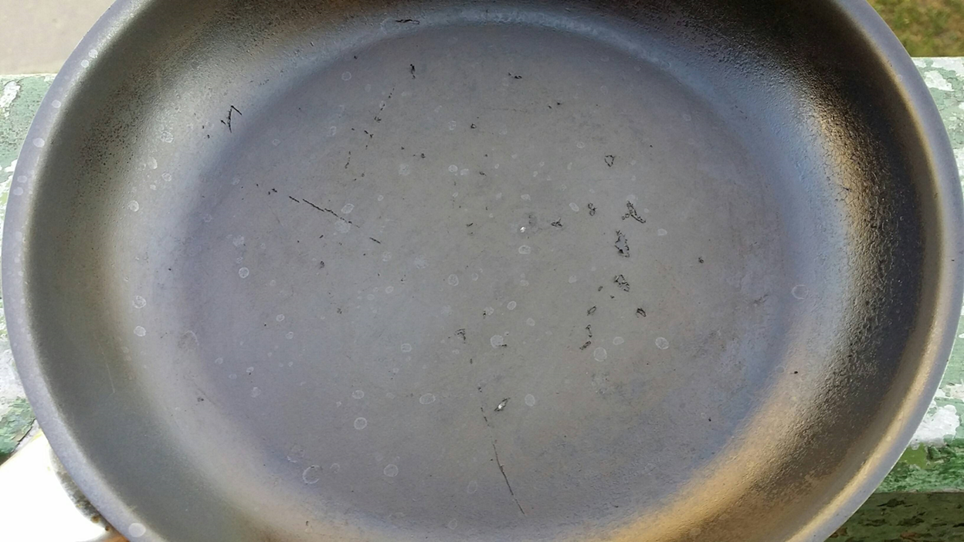
Replace non-stick cookware with cast-iron, stainless steel, glass or ceramic
Notes:
If your non-stick pots or pans are scratched or chips like in this image, they should be thrown out. The non-stick surface is toxic and can get into your food when the pan is in it’s prime, but even more so when there are scratches or chips. We don’t recommend buying non-stick cookware, especially second-hand. And when you are able, you can replace them with cast-iron, stainless steal, glass or ceramic pans instead.
Source: Health Canada on Safe Use of Cookware- https://www.canada.ca/en/health-canada/services/household-products/safe-use-cookware.html

Slide 33
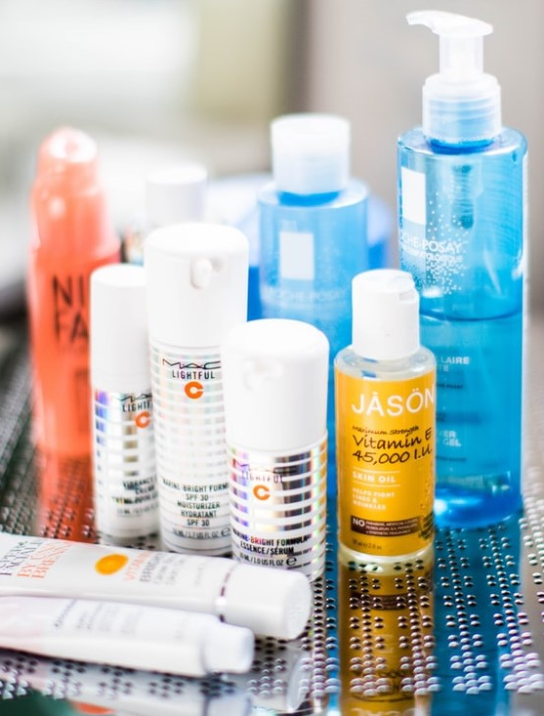
Personal Care Products
Your skin is your largest organ
Products on your skin can enter your body and build up inside
Some ingredients are known carcinogens, pesticides, and endocrine-disruptors
Notes:
Let’s shift to personal care products, what we put on the outside of our bodies as opposed to the inside of our bodies.
Our skin is actually our body’s largest organ.
And all the products we put on our skin, make their way into our body, into our bloodstream, and some build up the more we use them, because our bodies don’t have a system to expel the synthetic chemicals.
Unfortunately many ingredients in cosmetics and other personal care products are known carcinogens, pesticides, and endocrine-disrupters.
- If you want to learn more about this, check out the documentary “Toxic Beauty” that you can stream for free on CBC that talks all about the dangerous and harmful side of the cosmetic industry.

Slide 34
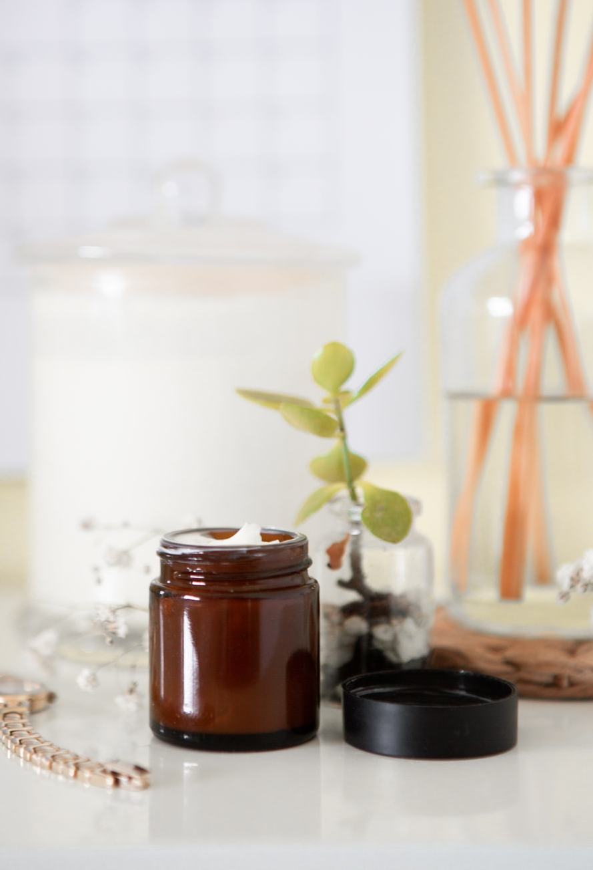
Tips To Reduce Exposure
Avoid unfamiliar, synthetic ingredients
If no ingredients listed, put it back or throw it out
Do research to find healthier products
Save money by using less
Go for the “WOW!” factor on special occasions
Notes:
Here are some simple tips on how to reduce your exposure to the toxic ingredients in cosmetics.
- In 2015 Canada passed legislation that ingredients are required to be listed on cosmetics and personal products. That’s not the case in other countries so if you are shopping online or outside of Canada, you may not be able to find out what’s in the products. You also want to be wary of products purchased inside Canada before 2015 and consider tossing them, as they likely do not list all their ingredients.
As much as you can, go with natural ingredients and do your research to find products with ingredients that are healthy for our bodies.
Find healthier products: you can use the “Think Dirty” app
A money saving technique is to not buy makeup at all, or use less often or wear it less heavy. This way you could really go for the “wow” factor on special occasions.
Sources:
Less Toxic guide to cosmetics and personal care- https://www.lesstoxicguide.ca/index.asp?fetch=personal
EWG Skin Deep - https://www.ewg.org/skindeep/
David Suziki Toxic ingredients in our cosmetics - https://davidsuzuki.org/science-learning-centre-article/whats-inside-counts-survey-toxic-ingredients-cosmetics/

Slide 35
Great Resources
David Suzuki's Queen of Green
Lesstoxicguide.ca
Health Canada
Air
Dust & MOULD
Plastics
Foods
Personal Care Products
Notes:
Here are some great resources that cover all of these topics and more. There is a lot of information on the internet, and not all of it is true. These resources are evidence-based and some provide examples of DIYs and other things you can do at home to create a Healthy Home environment.

Slide 36
Small Steps Can Make A Difference!
Air
Dust & MOULD
Plastics
Foods
Personal Care Products
Keep smoke/vape outside Go scent free Test for radon Install a CO monitor Go Pesticide-free | Dust and vacuum regularly Use natural or DIY cleaners Clean and prevent mould growth | Keep bags handy for shopping Store leftovers in glass or ceramic containers | Cook at home more often Choose fresh or frozen over canned when possible | Reduce use of cosmetics Choose products with natural and familiar ingredients
Notes:
A review of some simple actions you can take in each area, to empower you to create a healthy home for yourself, your family and your friends.
Air:
If you or someone in your life smokes or vapes and is unable or unwilling to quit at this time, make sure to Keep smoke/vape outside
Go scent free with your home products
Test your home for radon and carbon dioxide.
Dust/Mould:
Dust and vacuum regularly, minimize clutter
Use natural or DIY cleaners instead of the more toxic products you can find on the shelf.
Clean and prevent mould growth
Plastics:
Keep bags in your car, in your bag, or at your front door so that you remember to bring them shopping with you and you can refuse plastic produce bags and product bags.
Remember to store food, especially hot food or food that will be re-heated in glass or ceramic containers. Always always avoid plastics with hot food!
Foods:
Cook at home more often can save you money, keeps you aware of what you are putting in your body.
Choose fresh or frozen over canned when possible, so you can avoid the BP plastics.
Personal Care Products:
Reduce use of cosmetics, so you can wear less often or less at a time
Do your research, always look at the ingredient list and Choose products with whole and familiar ingredients

Slide 37
Your Homework
Make at least one written commitment to reduce your exposure to toxins.
Think of three friends or family members whom you could enlighten.
Use the brochure provided to educate each person.
Get each person to make a commitment on the brochure’s commitment form.
Notes:
1. Make at least one written commitment to reduce your exposure to toxic substances. When you are trying to identify what you can do, ask yourself these questions: Why do you want to change? Is there anything preventing you from changing? Why haven’t you made this change before now? How can you address those barriers to change? What are some things that could help you make this change?
Ex. Sticky notes around your home to remind you to bring a water bottle or reusable bag out of the house; give away your toxic cleaners so that you will be required to find/make an alternative; invite friends over for a make your own makeup evening; put white vinegar on your grocery list; take a red sharpie to your cleaning products and write “TOXIC” on them.
2. Think of three friends or family members whom you could enlighten. Hopefully these are people who you can work alongside. You can remind them of their commitment, and they can remind you of yours. You can all hold each other accountable and encourage each other to stay committed.
3. Feel free to use the brochure provided to teach these three people what you’ve learned about toxics.
4. Get each person to make a commitment on the commitment form. You will do this as well.

Slide 38
Your Homework
Record each person’s commitment (including yours) and contact information on the tracking form.
After at least 2 weeks, contact your participants to find out how they are doing with their commitments.
Record this and your experience on your tracking form.
Provide your instructor with any submission requirements.
Notes:
5. Record each person’s commitment and contact info on the tracking form (including your own). Tell them that you will follow up to see how they are doing in 2-3 weeks. (Accountability)
6. After about 2 weeks, contact your friends to find out how they are doing with their commitments. This follow-up is important, especially if you haven’t been following up during the these weeks. And you are encouraged to follow-up with them again after the 2 weeks, and you could ask them to follow-up with you about your commitments.
At the 2 week mark, ask them and yourself, do you want to add more positive actions?
7. Record their answers and your own on your tracking form.
8. Provide your instructor with any submission requirements.

Slide 39
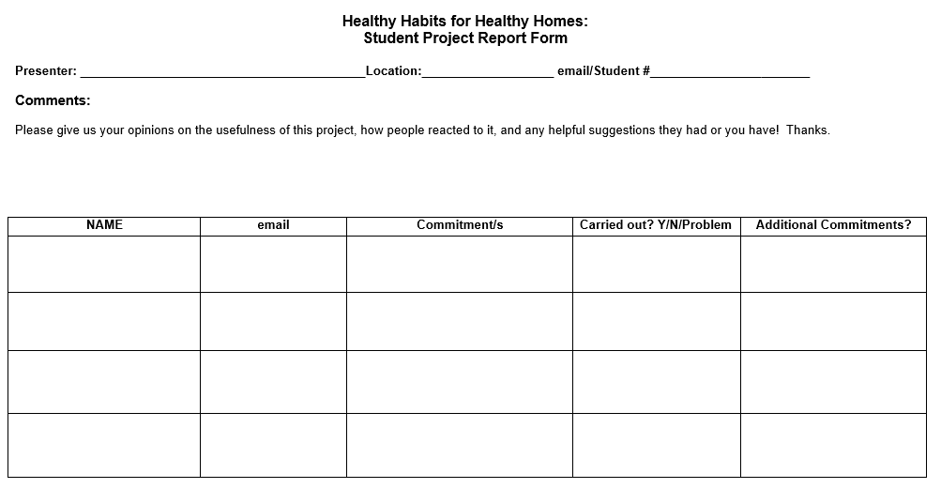
Homework Tracking Form
Notes:
This is the homework tracking form, or commitment form. You will record your commitment and progress and that of your friends of family.

Slide 40
Behaviour Change
Identifying barriers to change, ask yourself:
Why do you want to change?
Is there anything preventing you from changing?
Why haven’t you made this change before now?
How can you address those barriers to change?
What are some things that could help you make this change?
Notes:
To identify barriers that will hold you back or a key motivation that will help push you forward, ask the following questions:
Why do you want to change? Is there anything preventing you from changing? Why haven’t you made this change before now? How can you address those barriers to change? What are some things that could help you make this change?

Slide 41
Behaviour Change
Helpful examples
Sticky notes around your home to remind you to bring a water bottle or reusable bag our of your house
Give away your toxic cleaners so that you will be required to find/make an alternative
Invite friends over for a make your own makeup evening
Put white vinegar on your grocery list
Take a red sharpie to your cleaning products and write “TOXIC” on them so you don’t repurchase when they are empty
Notes:
Ex. Sticky notes around your home to remind you to bring a water bottle or reusable bag out of the house; give away your toxic cleaners so that you will be required to find/make an alternative; invite friends over for a make your own makeup evening; put white vinegar on your grocery list; take a red sharpie to your cleaning products and write “TOXIC” on them.
It’s also vital to change that everyone understands the content they just heard. If there is any confusion or questions about the content of the presentation, encourage participants to share that with the group so that you can clarify it.

Slide 42
Questions, Comments, Concerns?
FOR LISTENING

Slide 44
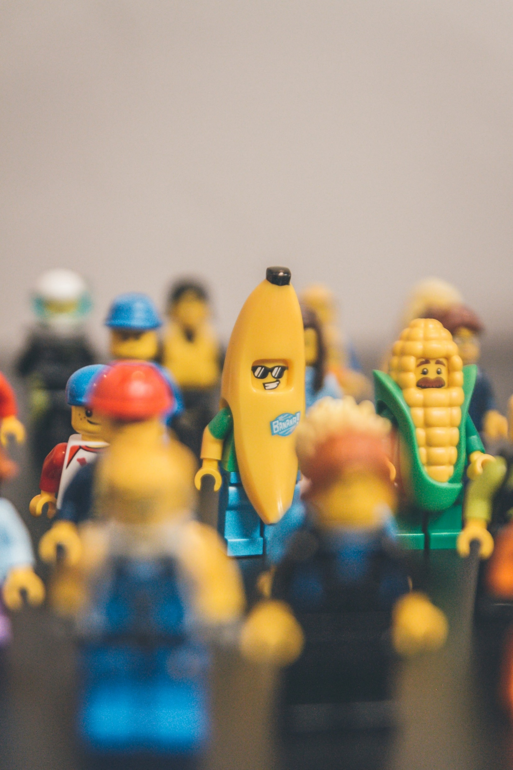
Toxics and Toys
Choose wood, metal, or cloth
Limit number of toys
Inspect metal costume jewelry for lead
Avoid Polymer Clay
Notes:
You could also avoid plastic altogether by choosing toys made from natural materials such as wood, metal, or natural clothes like cotton or wool. Choose toys made in Canada, the US, or the EU..
If you can’t purchase all new toys at this time, a first step you can take is reducing the number of toys your child has. Reducing your child’s collection of plastic toys by 25% or 50% also reduces their exposure to the toxic chemicals they might be emitting. Plus, studies have shown that that with too many toy options, kids can experience a “paradox of choice”, a paralysis induced by too much choice. Usually, kids keep reaching for the same toys again and again. Follow your kid’s lead.
Inspect any children’s jewelry for lead. Some indicators are that the jewelry would feel heavy for it’s size, and some items with lead can be ‘drawn’ with when dragged across a piece of paper.
Polymer Clay contains phthalates and PVC. Instead look for vegetable-based clays or recipes to make clay at home.

Slide 45
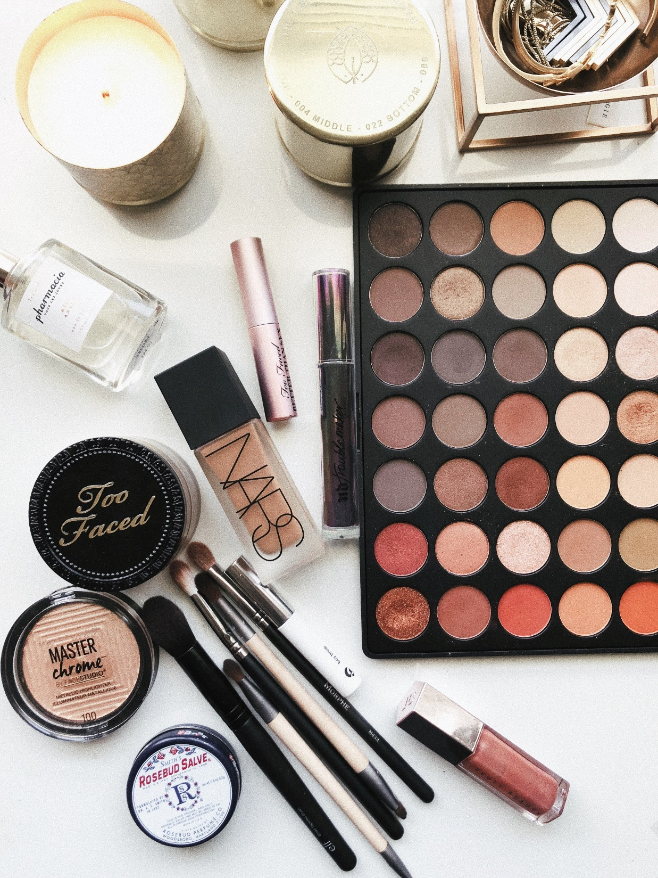
Cosmetics
EWG’s Skin Deep Cosmetics Database
The Dirty Dozen
Coal tar dyes
Parabens
Parfum or Fragrance
Triclosan
Notes:
EWG’s cosmetics database https://www.ewg.org/skindeep/
The dirty dozen on the David Suzuki foundation website. (Look for these in all personal care products, like shampoo, toothpaste, lotion, and shaving cream.)

Slide 46
Cosmetics
Lipstick: Lead, coal tar (kidney damage, miscarriage, nerve damage)
Eyeshadow: Talc (possible carcinogen)
Mascara: Parabens
Nail Polish: Formaldehyde-releasing preservatives
Notes:
Lipstick: Lead, coal tar, (kidney damage, miscarriage, nerve damage).
Parabens: possible endocrine disruptor and reproductively toxic. Found in many mascaras.
Talc: Found in eyeshadows. Possible Carcinogen, has an FDA warning.

